Slide 1
Class 10: Finish App Fraud Model, Build a Credit Score, Class Summary, ML Sate of the Art
HW 10 - Project 3 report
Build a credit score
Class review
Machine learning state of the art

Slide 2
Homework 10. Project 2 Report
Start each new section on a new page.
Include page numbers.
Title page, table of contents page
Executive summary: Describe the business problem. Then, what you did, FDR@3% for oot, estimated $ savings. This is written for a business executive and should be written from a business perspective, minimal technical details. Try to keep to one or two paragraphs.
Description of the data: Overview of data, statistics tables (the first two sections of the DQR), two or three of the important field distributions.
Data cleaning*: Exclusions, outliers, methods for imputation, from HW9.
Variable creation*: High-level description of reasoning, variable table from HW9.
Feature selection*: Methods and results from code. List of your final variables with the univariate filter measure.
Preliminary model explores: Brief description of each ML algorithm explored (maybe a paragraph and a picture).
Final model performance: Completely describe the final model: list all non-default hyperparameter choices. Three results tables (trn, tst, oot).
Financial curves and recommended cutoff: Plot of 3 financial curves, recommendation for cutoff. Use $4,000 for average fraud loss and $100 for each false positive. Import python cell from Project 1 code.
Summary: Describe everything you did. State the FDR@3% for oot, $ savings, other things you could do. This is written for a detailed reader of everything and should briefly review all the main technical points and processes. A few paragraphs is typical.
Appendix: full DQR.
*In these sections describe what, why, how.
Notes:
4

Slide 3
Template for grading informal report for supervised fraud model
If you do everything that I ask for you get a 19/20.
You can get additional points in any section, with the max total 20.

Slide 4
What You Need to Do For HW9, HW10
HW9: DQR, data cleaning, variables:
DQR: edit, run Data explore vs1_3 code. Study applications_clean_make_variables code.
This part is due next Tuesday midnight.
HW10: Project 3 report:
Feature selection: study and write up results from feature_selection_binary_classification code.
Exploring and tuning models: run applications_models code with several choices of models and hyperparameters to make the required table. Use vars_final_applications.csv. Also add in cell to make financial plots for cutoff decision.
Assemble all these pieces into a professional project report, same structure as for Project 1.
This is due June 11 midnight. Then the graders need to finish grading by June 15, then I need to combine all, do the distributions, set letter grades and submit by June 17.

Slide 5
Assignments and Grading
10 homeworks at 10 or 20 pts each
Total possible points is 140: 130 homeworks + 10 participation
The final % grade doesn’t map directly to the letter grade. The final point scale will be adjusted so that the about half of the students get A’s, half B’s.
Homeworks due Tuesday midnight before Wednesday’s class.
10 points of the grade is participation. Please ask questions during class.
If you do your homeworks reasonably well, on time, complete, you will do fine. You’ll likely get a B or A (+/-), primarily depending on how well you do on your homeworks.
It’s hard to get a C in this class. Only way to get a C or lower is to not complete the homeworks well or on time.

Slide 6
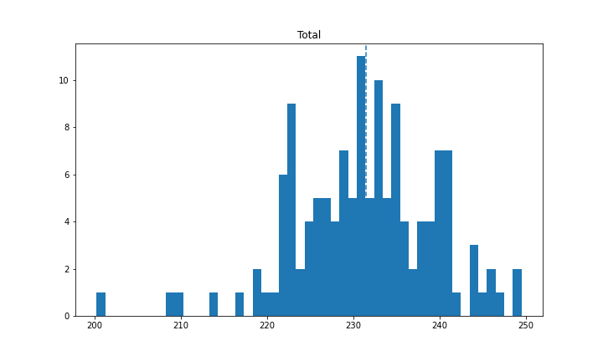
Assignments and Grading
Recall from Class 1
median
B-, B, B+
A-, A
The final % grade doesn’t map to directly to the letter grade. The final point scale will be adjusted so that the about half get A’s, half B’s.

Slide 7
Building Credit Scores Using Machine Learning
August 2024
Stephen Coggeshall

Slide 8
What is a Credit Score?
A credit score predicts the likelihood that a person will pay back a “loan”.
“Loans” include
$’s lent, like for a mortgage, auto, student, home improvement…
Services paid for after they’re used, like a credit card, BNPL, phone usage, utilities, Netflix, medical, …
Credit scores are used for
New account origination: application score. This scores an application.
Likelihood that an existing account will continue to pay: behavior score. This scores an existing account that’s not already delinquent.
Likelihood that a delinquent account will be paid: collections score. This scores a delinquent account.
“Reputation” measurement of a person for apartment, employment, security clearance, insurance… Typical FICO-like score. This scores a person.
These different types of scores are all built differently, primarily in the design. Some important design issues:
The thing being scored (application, existing account or person)
The data that goes into the score
What records are used to build the score
How to define the target/dependent variable
How to treat time

Slide 9
Some History of Credit Scoring
Lending was mostly manual and judgmental before the 1950’s.
Statistically-built score models/scorecards used from the late 1950’s. These were built both in-house and by vendors (e.g., FICO).
FICO introduces a general-purpose application credit score in 1989.
Many large banks continue to build their own versions for both applications and existing accounts, along with outside vendors (FICO, many others)
Around 2010 alternative credit scores became desired. Alterative meaning they used alternative data besides just application, account and/or bureau. Example alternative data sets: utility payments, rent payments, identity information, social network data…
Also around 2010 nonlinear machine learning models became acceptable to regulators and expanded the sophistication of tools used for model building. Up until this point credit scores were mostly logistic regressions. Now they include many nonlinear machine learning algorithms like boosted trees, random forests, and neural nets.

Slide 10
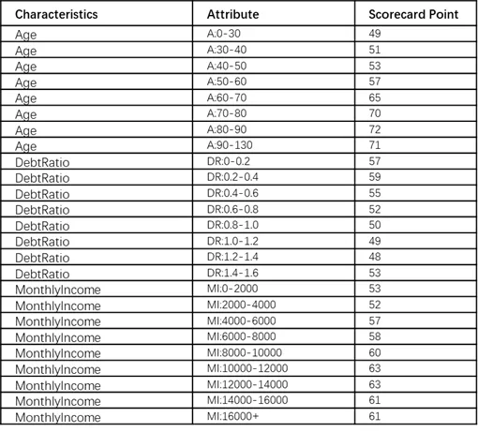
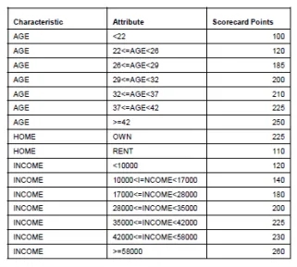
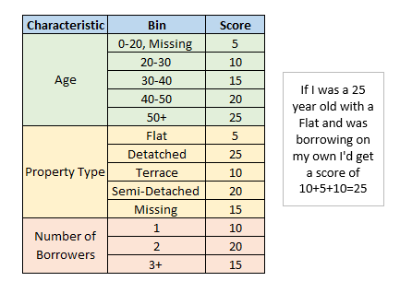
Example of Simple Credit Score Cards
were

Slide 11
Recent Advances in Credit Models
Alternative data. Helps the underbanked: thin file, no hits
Mainstream, classic credit models use data from
Application: application and credit bureau
Behavior: account and credit bureau histories
In the past ~15 years there’s been a wide increase in using alternative data: payment data from phones/utilities/rent/payday loan, asset ownership, professional licenses…
Nonlinear models. Use of BTs, NNs, RFs for credit scores
Must be able to provide to the consumer which variables are driving their score value (reason codes)
Matrix decisions using two scores: Matrix classic FICO score with alternative credit score
A 2D matrix allows swap ins/swap outs over the single FICO score
Allows accepting people who normally would be rejected
Credit models are highly regulated in the US for the data they use, the algorithm, explainability and disparate impact

Slide 12
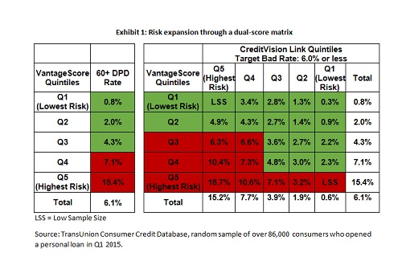
Typical to “Matrix” Two Scores
Alternative credit score
Example from the TU presentation
Swap outs
Traditional credit score
Decision boundary when using traditional score only
Swap ins
Using two scores together in a matrix allows
Acceptance of applicants who would otherwise be rejected (swap ins)
Rejection of likely bads that otherwise would have been accepted (swap outs)
Reduction in overall bad rate

Slide 13
Some FICO Score Alternatives
FICO assembles bureau data for the model.
VantageScore. Built by the 3 main bureaus (Experian, Equifax, TransUnion) as a competitive algorithm/score to FICO.
Experian Boost score. Allows the addition of payment of other types of bills.
TransUnion CreditVision for account origination.
LexisNexis RiskView Optics, Spectrum, Payment Score.
SageStream Credit Optics uses bureau, phone/utility and identity data.
CoreLogic Anthem Credit Score.
Scorelogix JSS Credit Score.
…

Slide 14
Credit Scores are Generally One of Two Types
Application score – scores applications for new account openings. Uses all data on the application, but primarily credit bureau info.
It scores an application and we look for data about the applicant(s).
If little or no bureau data exists for that person, it’s called a thin file/no hit. Special scores are built and used for thin file/no hit.
Frequently build specific scores for the type of account (revolving, installment, auto loan…)
The FICO score is the most commonly used credit score for applications, even though it score a person rather than an application. The FICO score only uses bureau data.
Behavior score – scores an existing account. Relies mostly on historical behavioral data about the account, but can also add in credit bureau data about the account owner(s).
Some special types of behaviors scores include a bankruptcy score, collection score, etc.
Frequently build specific scores for the type of account, similar to what we do for application scores.

Slide 15
Data Used for the Score Depends on the Thing Being Scored
Application score: uses data on the application and bureau data.
Behavior score: uses data on the existing account behavior and (usually) also bureau data.
Person score (FICO): uses bureau data only. This is what is typically/generically referred to as a credit score.

Slide 16
How Do Businesses Use Credit Scores
Uses for financial decisions:
Deciding which applications to accept/reject.
Pricing for a new account. Interest rate, fees, credit limit…
Request higher collateral (deposit, downpayment…).
Increase account insurance, PMI…
Above-the-limit authorizations.
Increase/decrease credit limit.
Proactively close an existing account.
New marketing offers.
Decide which loans to keep on books and which to sell.
How to price an existing loan or loan portfolio for selling it.
…
Other uses:
New hire investigations, background checks, “reputation” measures…

Slide 17
Goods, Bads, Indeterminates
A credit score is typically a binary classification type score, where we try to predict if something will be either good or bad. The score then represents the likelihood of being good/bad.
To build this kind of score we prepare a bunch of data records where each record is a particular example of a good or bad.
We call the records goods whose outcome is good (pay the credit) and bads whose outcome is bad (don’t pay).
We make many thousand of such records and show them to a machine learning algorithm (a statistical model), and it “learns” how to distinguish between a good and a bad.
The statistical algorithm generally learns this distinction more easily if we show it records that are clearly good and clearly bad, and not records that are somewhat in between.
So when we prepare data we make our goods and bads from the definite examples, but we remove records that are not clearly good or bad. We call these indeterminates.

Slide 18
Design of a Single Record for Modeling
Predictive models predict something in the future based on the present and past state of things. We design our modeling records with this principle in mind.
*Also called the scoring time
Historical period
Observation* time
Performance period
Independent variables x
Dependent variable y
When building a modeling record we “pretend” that we’re sitting at the observation time. We measure the dependent variable y in the performance period. We build our modeling input variables x using the historical period.
Usually the performance period and the historical period have a definite time window length, for example
Performance period: 6 months. Generally, the farther in the future the more useful but less accurate the model.
Historical period: 12 months. Try to include a complete cycle of seasonality.
We make as many of these modeling records as possible given our data.
After it’s built the predictive model is y = f(x). It predicts y given the variables x.

Slide 19
Design for a Loan Application Credit Score
For each account we build one record for modeling.
Can use any allowed data during this time as inputs to the model
Use data in this time to define the record’s dependent variable y
Historical period
Observation time
Performance period
Independent variables x
Dependent variable y
Application time
Some design questions
Data on the application
Bureau data
Data about the person applying
Think carefully about how to define the good/bads/indeterminates.
Default/delinquency on that particular loan?
Delinquency on any loan as seen in the bureau data?
How big are the time windows for the historical and performance periods?
For an application score there is only one observation time: the time of the application.

Slide 20
Design for a Loan Behavior Credit Score
For each account we can build many records for modeling.
Can use any allowed data during this time as inputs to the model
Use data in this time to define the record’s dependent variable y
Historical period
Observation time
Performance period
Independent variables x
Dependent variable y
Any previous month
Data from the existing loan
Bureau data
Data about the person applying
Need to carefully design rules for the “bad” definition.
Typically 3 months or more delinquent.
For a behavior score the observation time can be any of the times (typically months) during the account history. This means we can build many modeling records from a single existing account!
How is this done?

Slide 21
What Existing Account Data Looks Like
Timeline for a particular account
Customers
Start here
Today
Time
Applicable to credit cards, investment accounts, Netflix, Safeway, Sam’s Club….
For each time point (observation time) make as many records as possible, then shift the time point forward

Slide 22
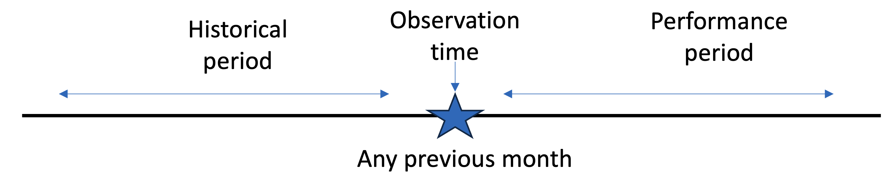
How to Build Data Records for Existing Customers
x
y
Independent variables x
Dependent variable y
Each customer’s account history
x
y
One customer’s history makes records
x
x
y
y
x
x
y
y
x
x
y
y
x
x
y
y
x
x
y
y
x
x
y
y
x
x
y
y
x
x
y
y
For each customer’s history, build as many data records as possible by stepping forward the observation time
x
x
y
y
x
x
y
y
x
x
y
y
x
x
y
y
x
x
y
y
It’s fine that they overlap
x
x
y
y
x
x
y
y
Time
This is how we build records for these types of scores:
credit behavior, fraud, target marketing, churn/retention…

Slide 23
Design: Inclusions/Exclusions
Only include records of the type that will be scored during model use.
We exclude people who are special, who likely behave differently from the population for whom the score will be used. Examples:
Company employees
High net worth people
Politicians
Rock stars
Also exclude records that are not in the condition for which we care about the score. Examples:
For collections scores, only use records that are in collections (arrears)
For behavior scores, only use records that are current (not in arrears)
For an attrition/churn model, only include accounts that are active at the observation period. Don’t include people who are “dead” (inactive) in a model that will predict who will be “dead” (inactive) in the future.

Slide 24
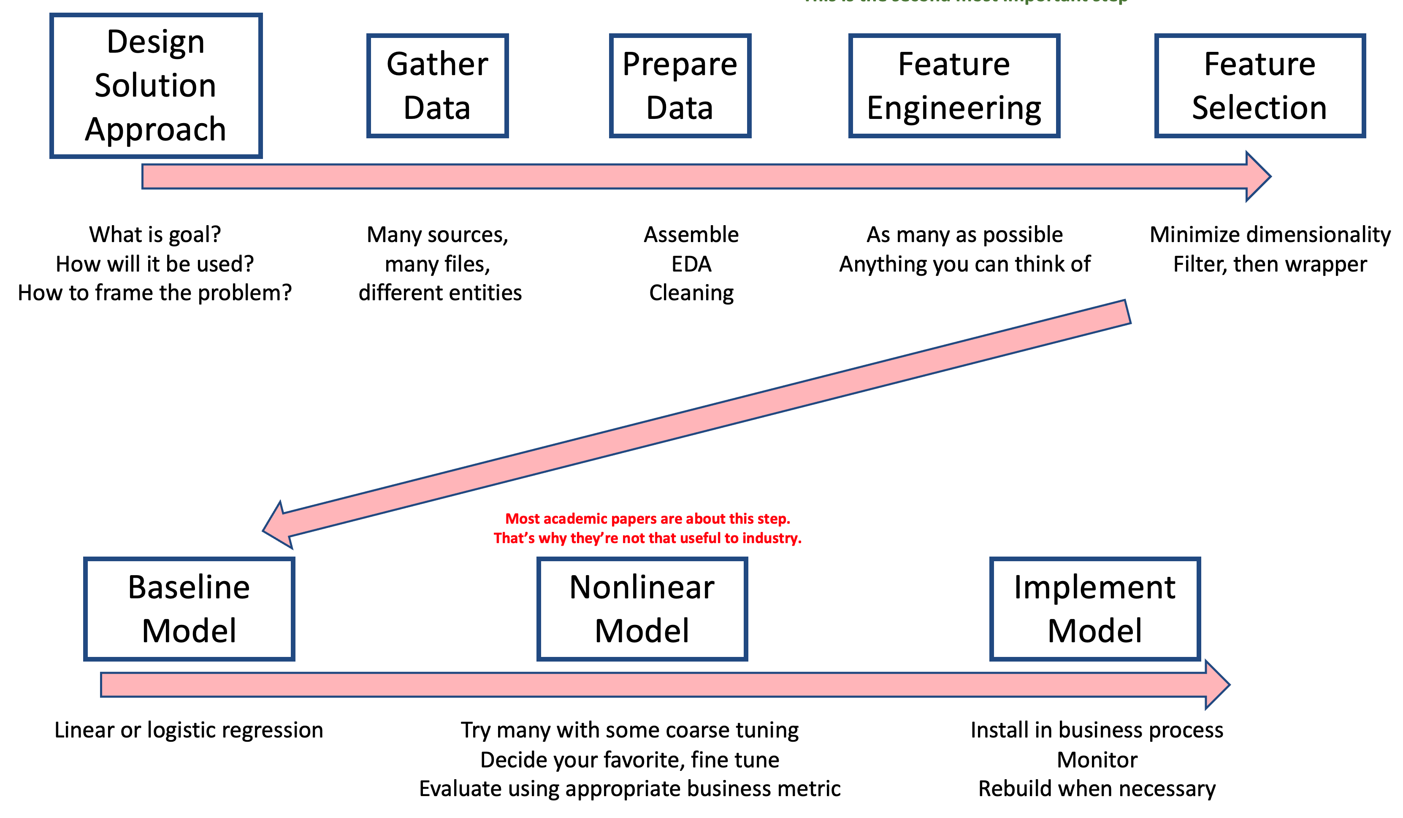
Example of Building a Credit Score Model
1
2
3
4
Some design issues
Assembling data for models
Building expert variables
Feature selection
Divide data into training/testing
Building/evaluating models
Examining business results
5
6
7

Slide 25
Example of Building a Credit Score: Lending Club
Lending Club originates unsecured peer-to-peer personal loans.
Business problem: predict which existing loans will go bad. This is a behavior score type credit prediction.
Data is real, from Kaggle web site https://www.kaggle.com/datasets/adarshsng/lending-club-loan-data-csv
887,379 loans issued from 2007 through 2015
Pretty good data, 887,379 records by 74 columns
Can be used to build a behavior score. Recall, a behavior score measures the risk of an existing loan, not for originating a new loan.
We have only one point in time for all the accounts, so we can build one only record/account.

Slide 26
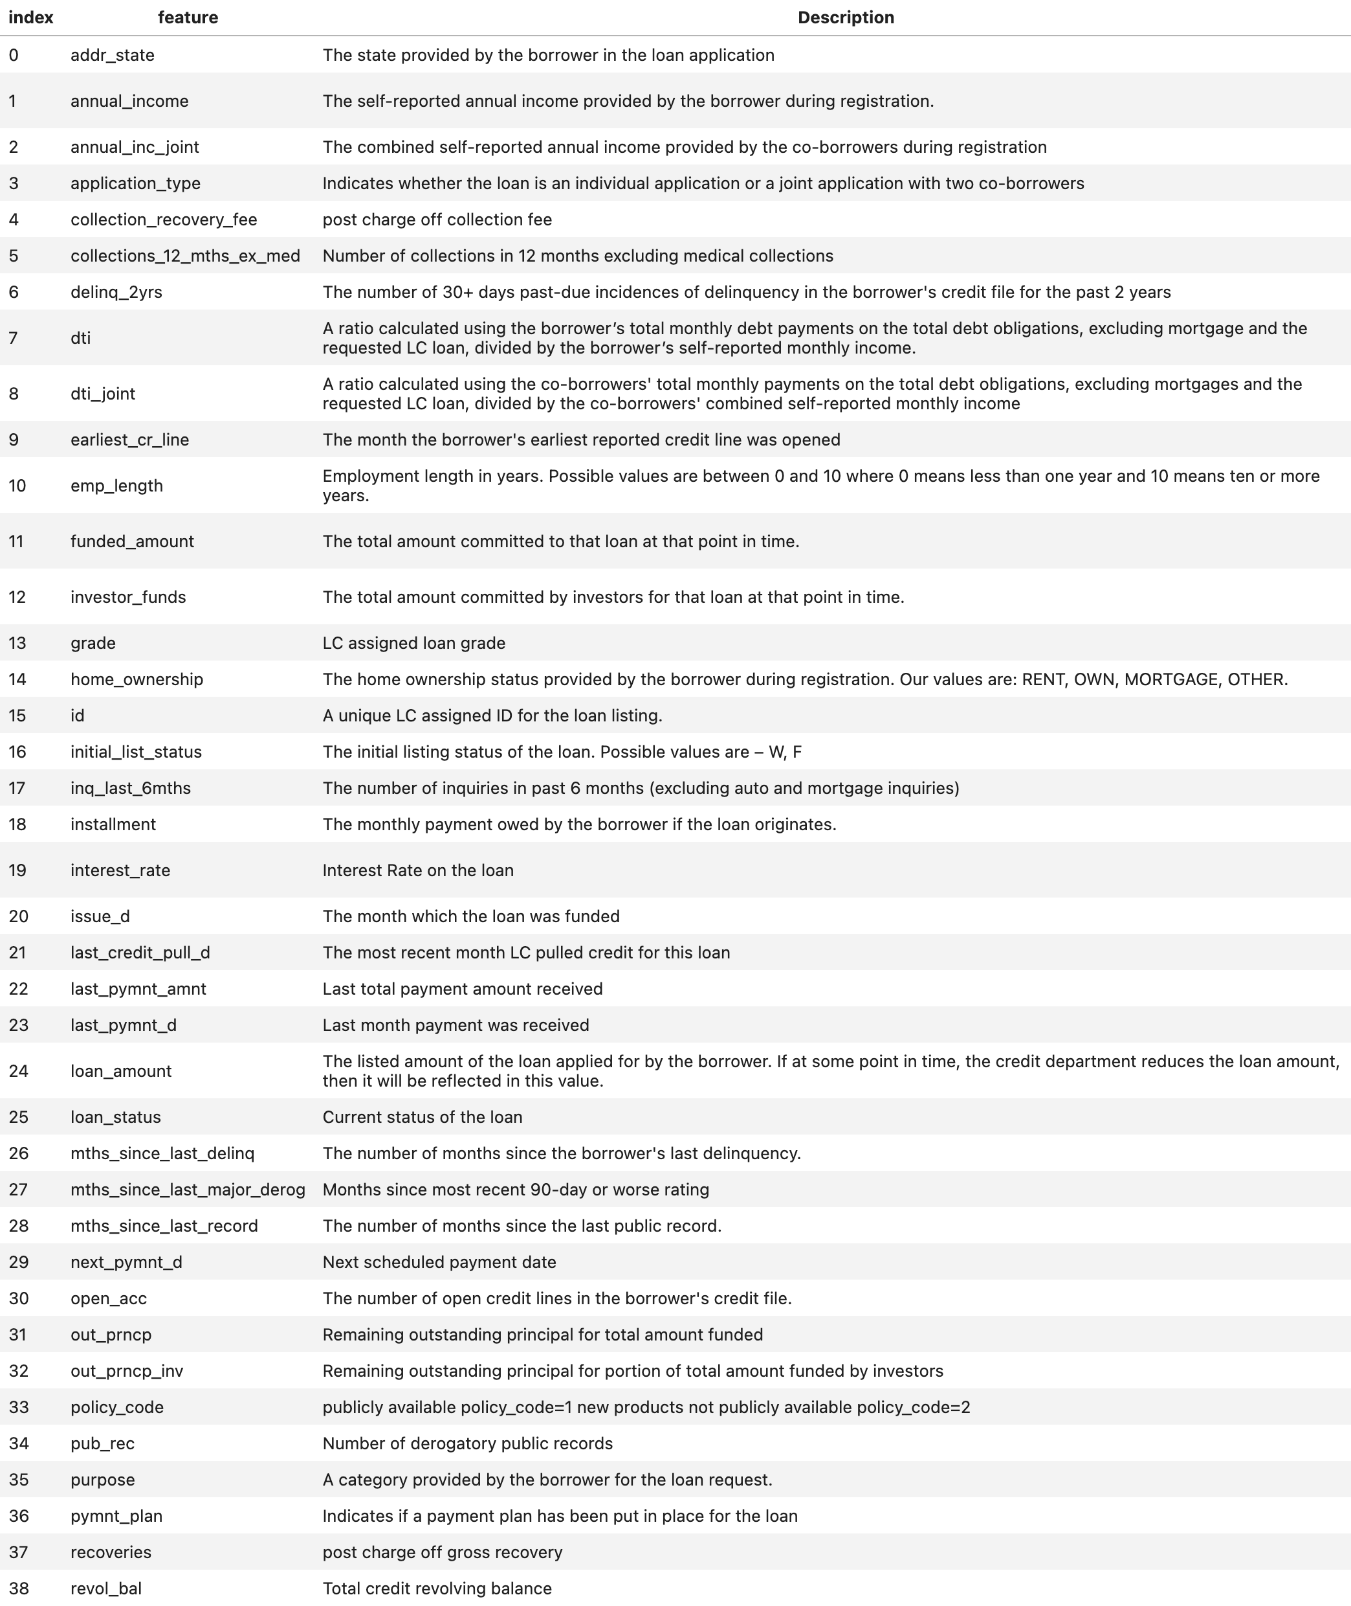
Data Fields 1
Lots of pretty good fields.

Slide 27
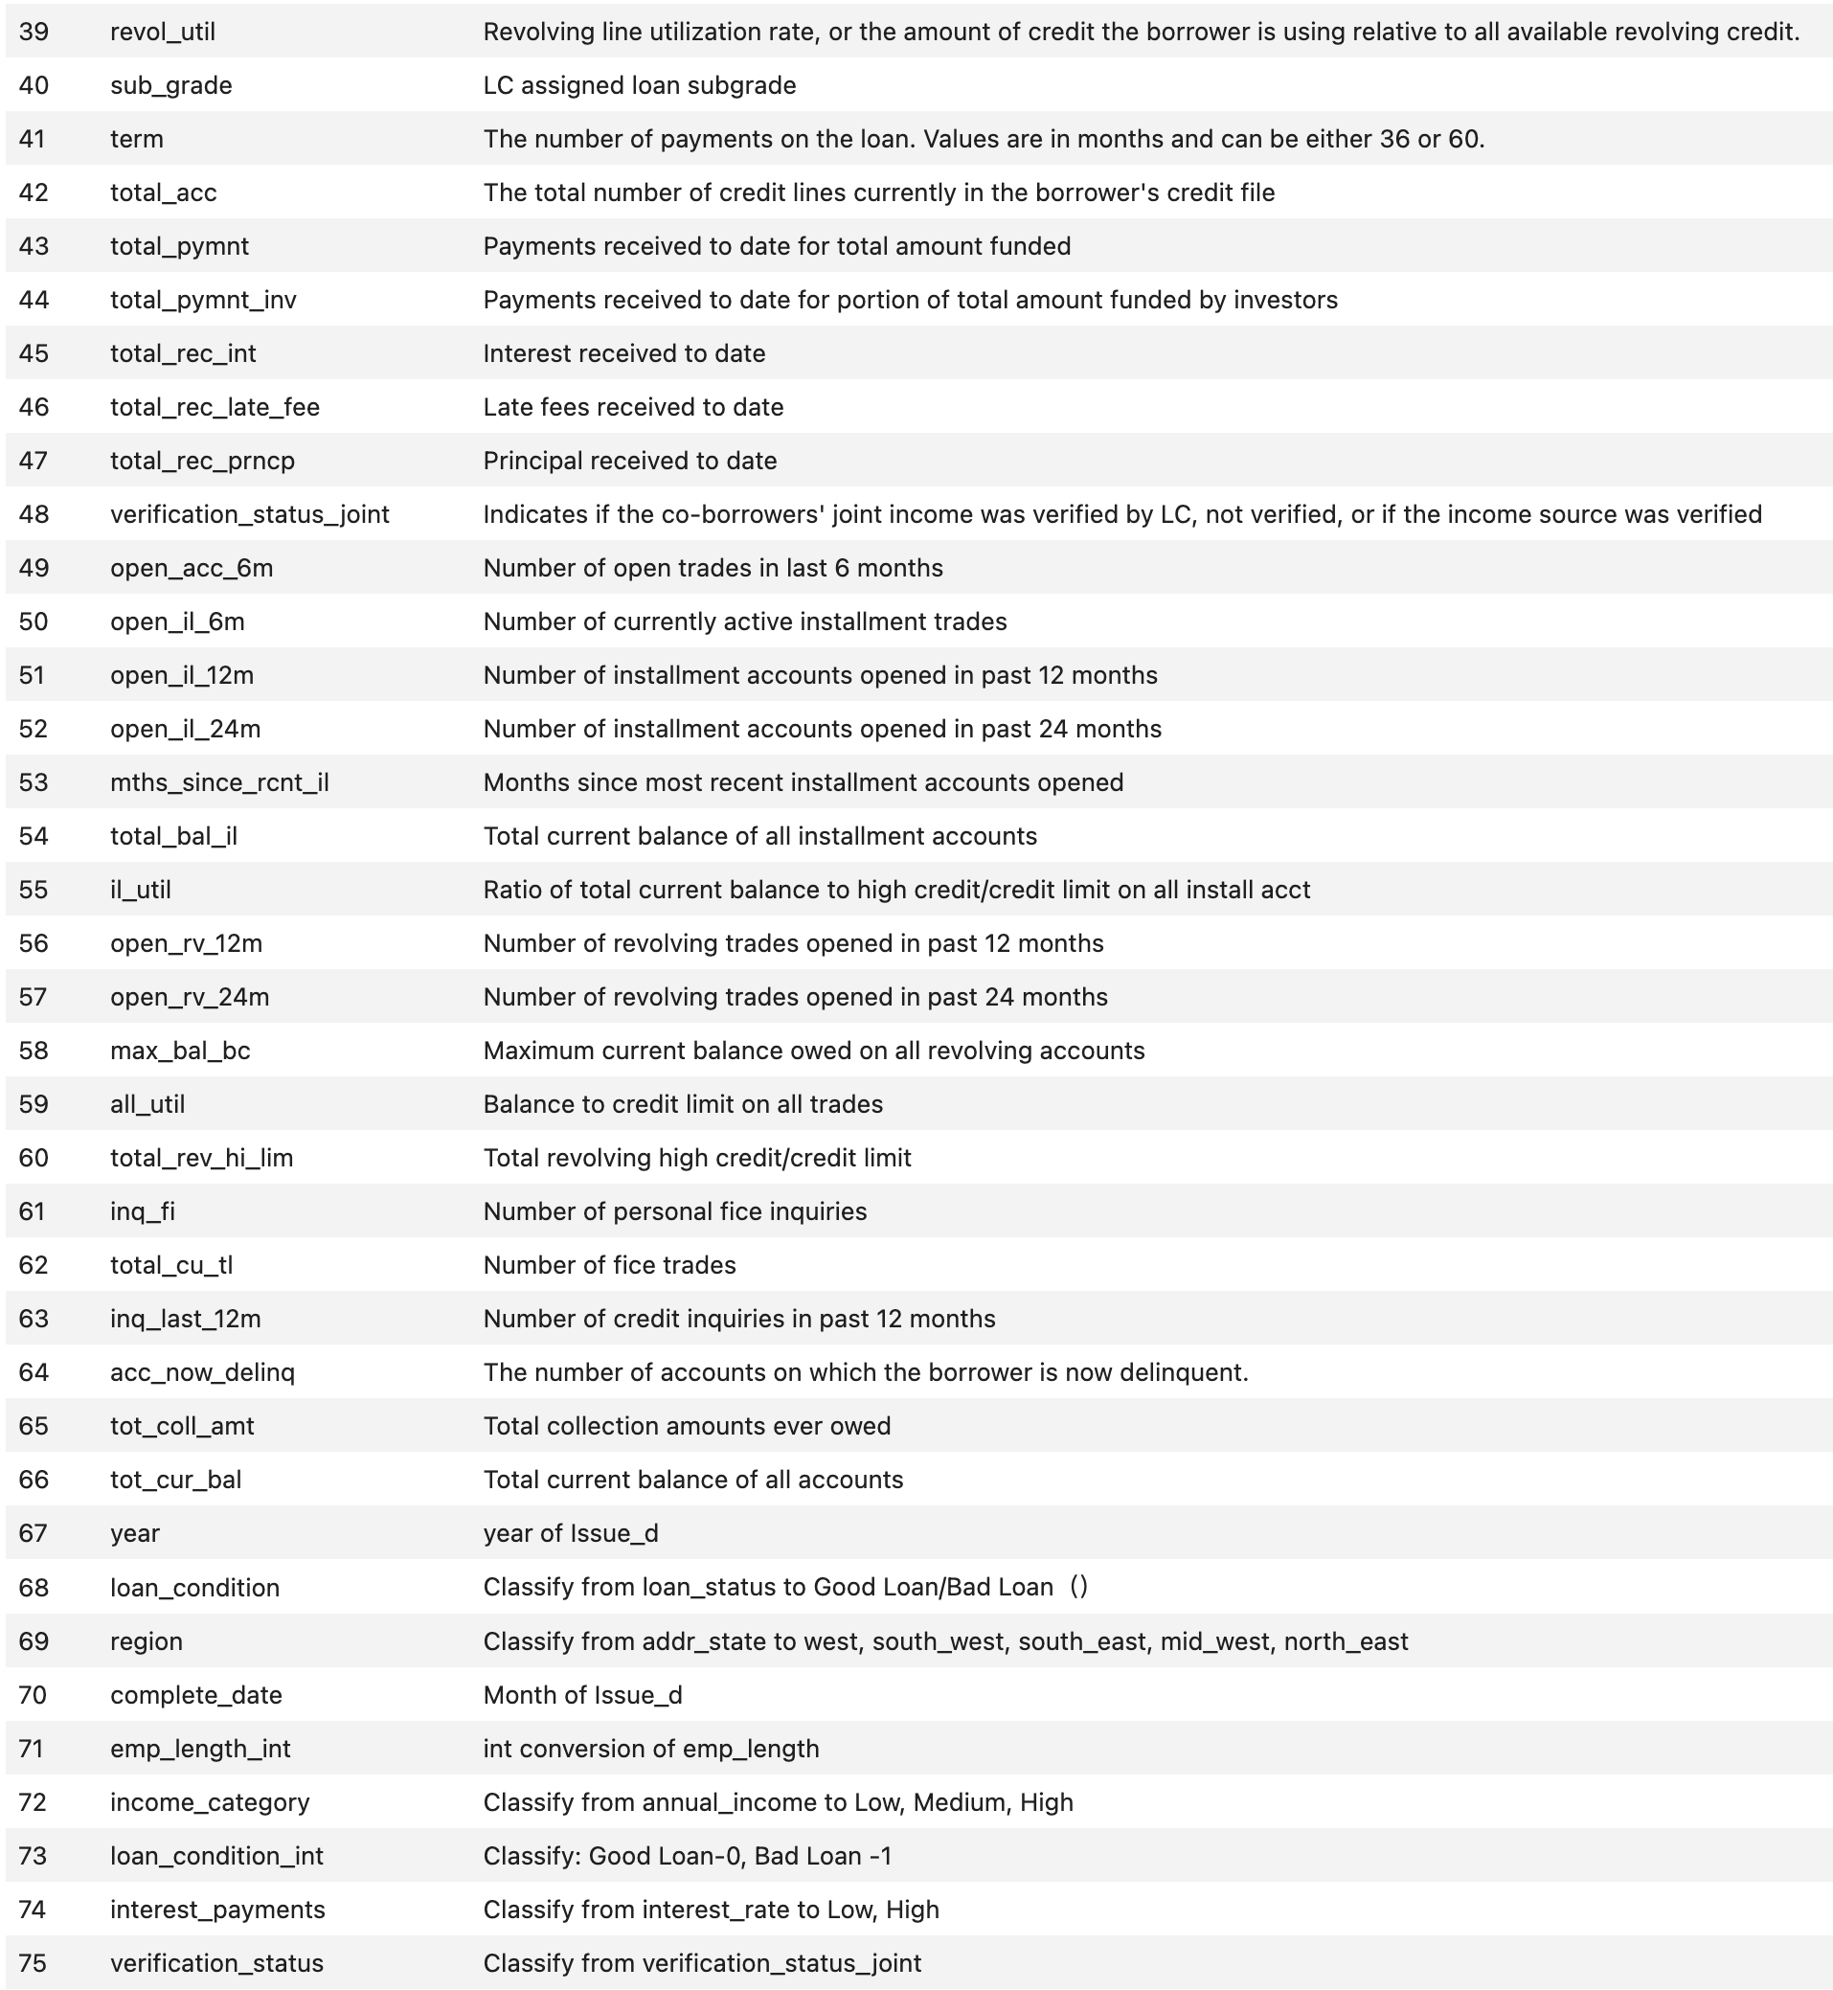
Data Fields 2
Lots of pretty good fields.

Slide 28
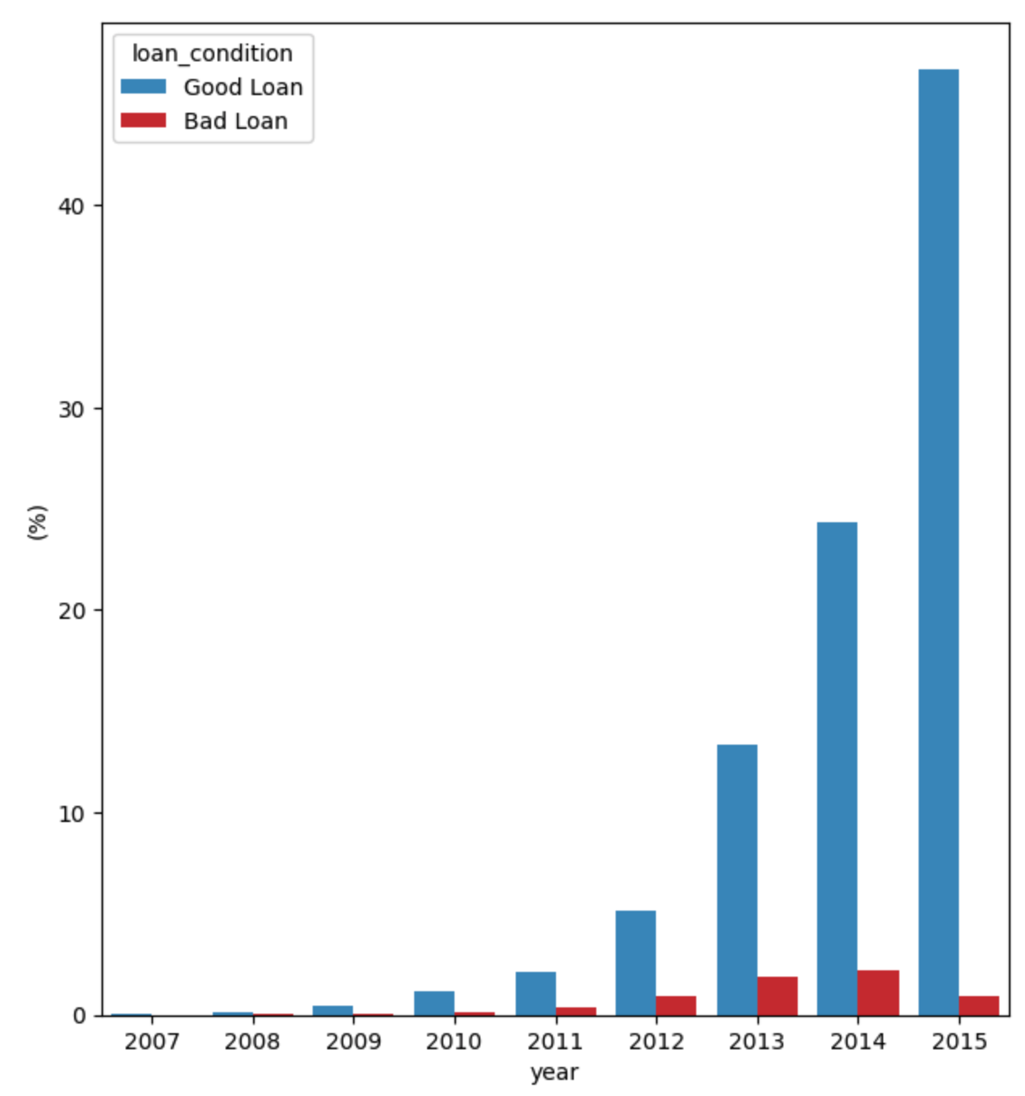
Good/Bad Loans by Year
I’m suspicious about this lack of bads in 2015. Likely the loans hadn’t had enough time to mature when the data was pulled.
There are lots of issues with this data set and particular problem, but still it makes a pretty good example of the process.

Slide 29
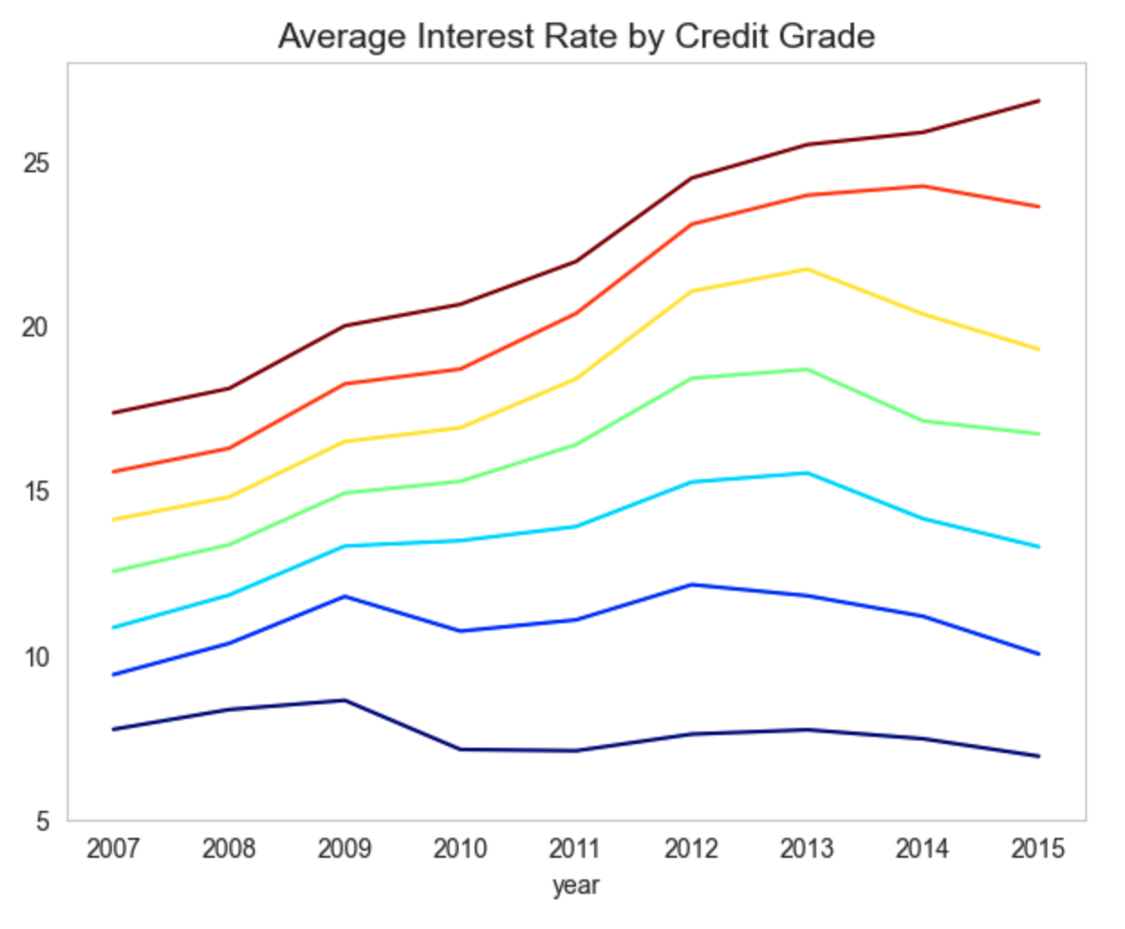
Loan Interest Rate by Time and Credit Class
G
Certainly the riskier loans were given higher interest rates.
So keep in mind that the interest rate is indicative of the loan risk, which can cause unexpected target leaks.
For example, having a high interest rate could be incorrectly thought to predict a loan to go bad.
F
E
D
C
B
A

Slide 30
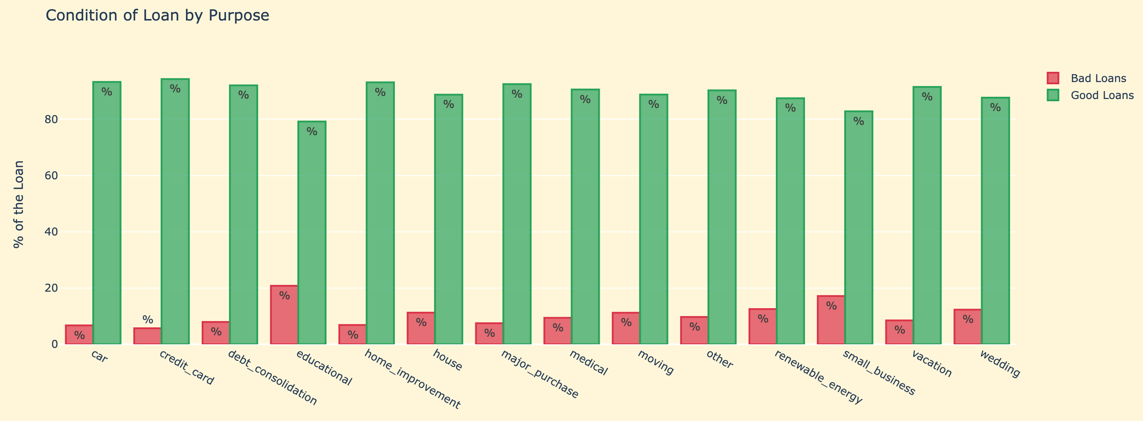
Good/Bad Loans by Loan Purpose
17%
9.8%
8.4%
9.9%
11%
16%
12%
Highest bad rates circled

Slide 31
Important Model Design Issues
Purpose: What is the business purpose? How will the score be used?
Entity: What “thing” will be scored? An application? An existing account? A person independent of any particular account?
Data: What data to include/exclude:
What data sets can be available both to build and use the score?
What particular records to include/exclude from the model build?
Note: We don’t have an expert domain business lead on this problem so we are making the decisions as best as we can. No claim that these design decisions are the best, but they’re OK for our demonstration of building a credit score.
We’ll choose this

Slide 32
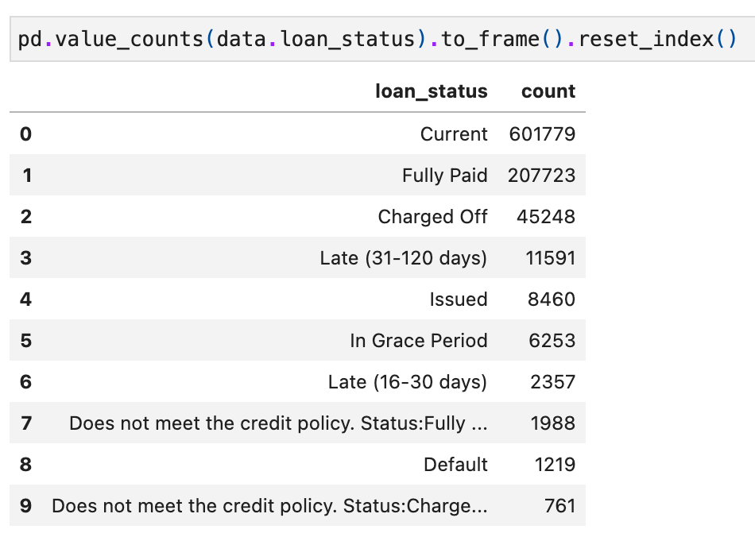
Some Design Decisions. Requires Business Guidance
Define the dependent variable:
Remove some fields that may be target leaks: Drop any fields that may improperly indicate good/bad. I dropped
total_rec_late_fee, recoveries, collection_recovery_fee, out_prncp, out_prncp_inv, total_rec_prncp, total_rec_int, acc_now_delinq, collections_12_mths_ex_med, tot_col_amt, member_id, emp_title, usr, desc, zip_code, title, issue_d, complete_d, year, interest_rate
Decide train, test, validation design:
Data is large, so OK to use all for feature selection and target encoding (not typical but makes it easier).
Set aside a random 20% for validation after the models are built.
Do bootstrap model building with 70/30 train/test split for each build.
Choose the goods and bads as the ones we are pretty sure about.
If we’re not sure, call them “Indeterminate” and don’t use them for the modeling.
817,962 Goods: Current, Fully Paid, Issued
58,058 Bads: Charged Off, Late (31-120 days), Charged Off
11,359 Indeterminates: In Grace Period, Late (16-30 days), Does not meet…
I tried to remove fields dealing with interest rate, late fees…

Slide 33
Data Cleaning
We remove fields that have too many missing values
We then just use the detailed credit class field “sub_grade” to impute the other field missing values. This isn’t necessarily the best thing to do but it demonstrates a reasonable and most common approach for field imputation.
For example, about 5% of the records are missing the field for length of employment, “emp_length”. So when a record is missing this field emp_length, we fill in this missing field value with the average of that field for all records that have the same value of the record’s credit class:
Group records by credit class
Fill in a missing field with the average of that field for that credit class.

Slide 34
Building Variables From the Fields
After the design decisions, this step is the next most important.
Requires detailed understanding of the fields and business goals.
We don’t really have these for this problem, so we just make the best choices we can.

Slide 35
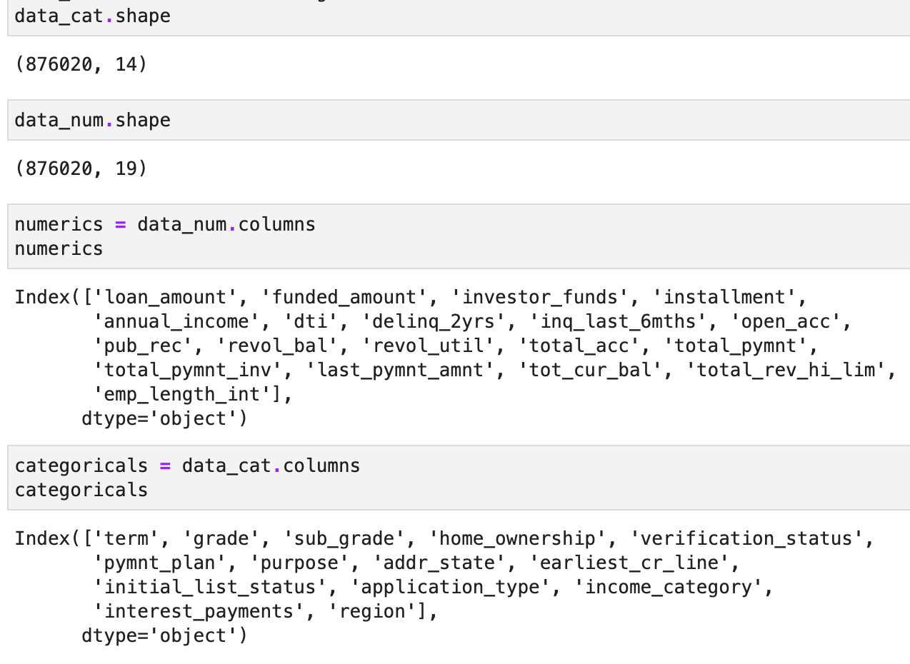
Separate Fields Into Numeric or Categorical
We must distinguish between fields that are numbers (numeric) and fields that are just categories (categoricals).
We use different methods to build variables for numeric and categorical fields, so we first decide which fields are categorical and which are numeric.
We have 33 fields remaining for which to build variables. 19 of these fields are numeric and 14 are categorical.
Count the categoricals
Count the numerics
List the numerics
List the categoricals

Slide 36
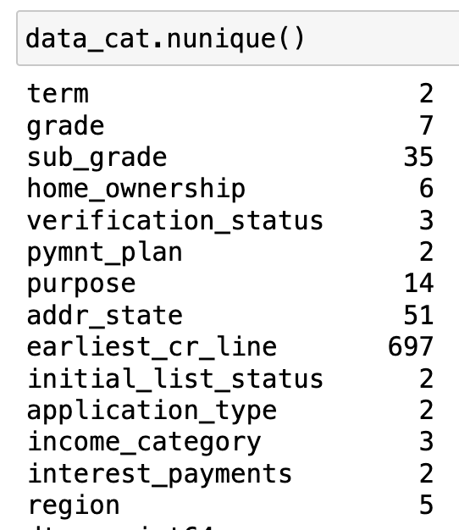
Build Variables from the Fields
We really should use expert guidance to build good variables, but we don’t have this for this problem. So we just do some very generic things.
Numeric fields to variables:
Each numeric field becomes a variable: 19 variables.
We make all possible ratios of all numeric fields: 19*18/2 = 171 variables.
Categorical fields to variables:
We look at the cardinality of the 14 categoricals:
Total number of candidate variables for modeling is 19 + 171 + 37 + 64 = 291.
If the cardinality isn’t too high we do one hot encoding. We do this for 11 of the 14 categoricals. This makes 37 variables.
If the cardinality is bigger than 2 we also do target encoding. This makes 64 variables.

Slide 37
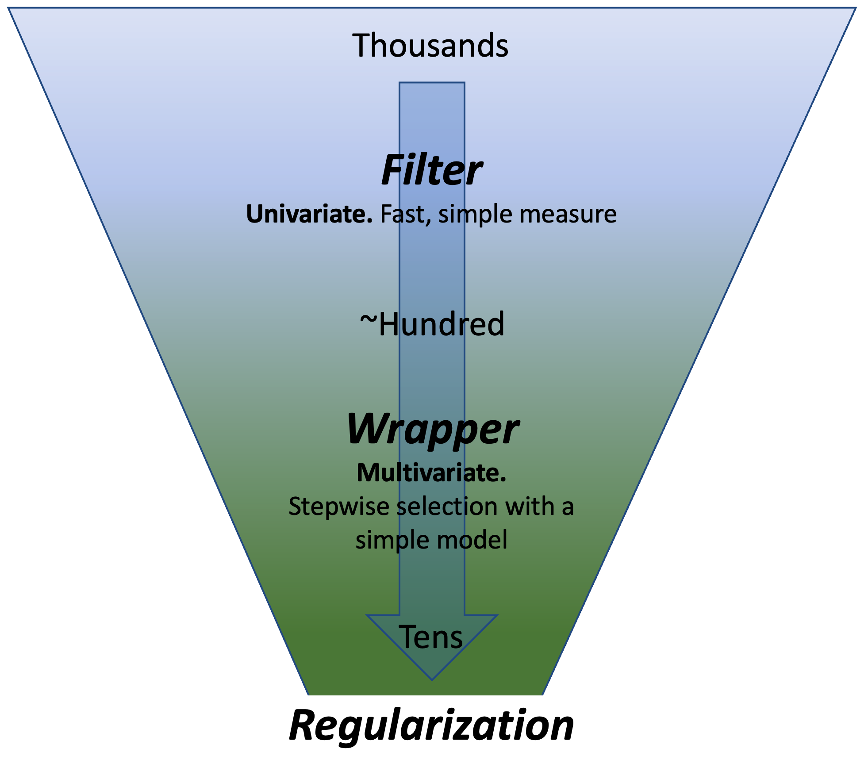
Feature Selection
Nonlinear models struggle when there are too many input variables. We have 291 candidate variables.
Reducing the number of variables also makes the models run faster, so we can do better in exploring model parameters (tuning the models).
The classic way to reduce the number of variables for supervised models is feature selection, meaning we select only some of the candidate variables and throw away the rest.
We use a simple and fast method to throw away about 80% of the variables (filter).
Then we use a slow but better method to get to a final short list (wrapper).

Slide 38
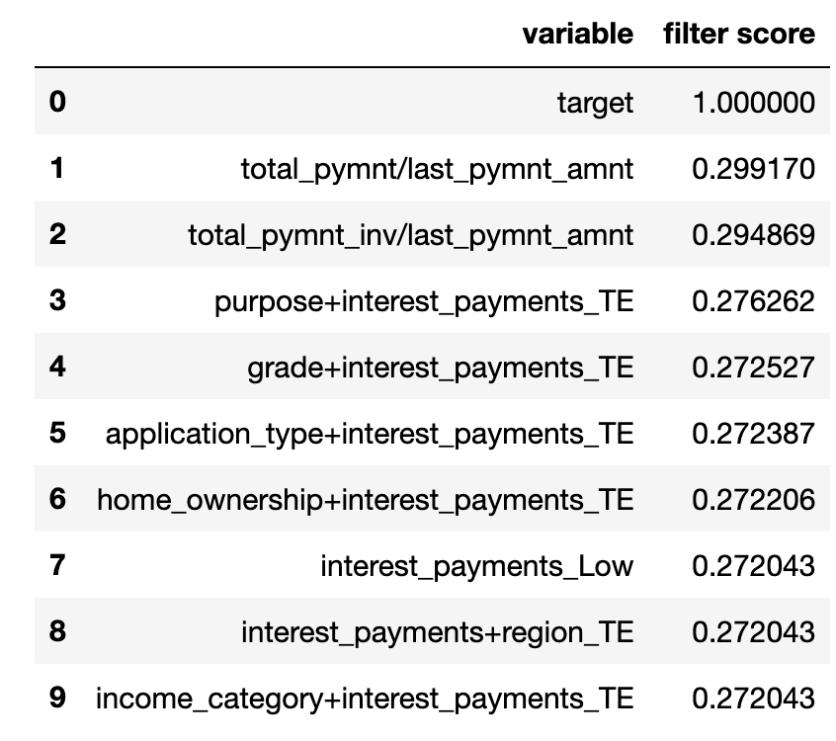
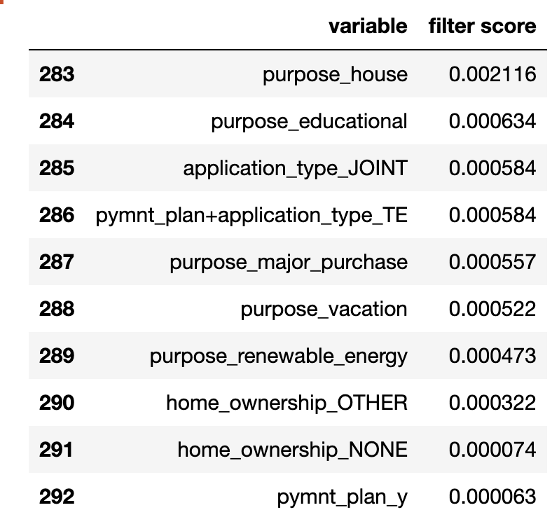
Feature Selection: Filter
We start with 291 candidate input variables.
For each variable we do a univariate test to see how well that input variable by itself predicts the dependent variable.
We can use any reasonable measure of goodness, and a quick and good measure for a binary classification (good/bad prediction) is a KS test. The higher the KS the better.
We use this filter method to throw away all but the top 40 candidate input variables.
Top 10 predictive variables
Bottom 10 predictive variables
I include the actual dependent variable here as a sanity check. It’s a perfect predictor of itself.
…

Slide 39
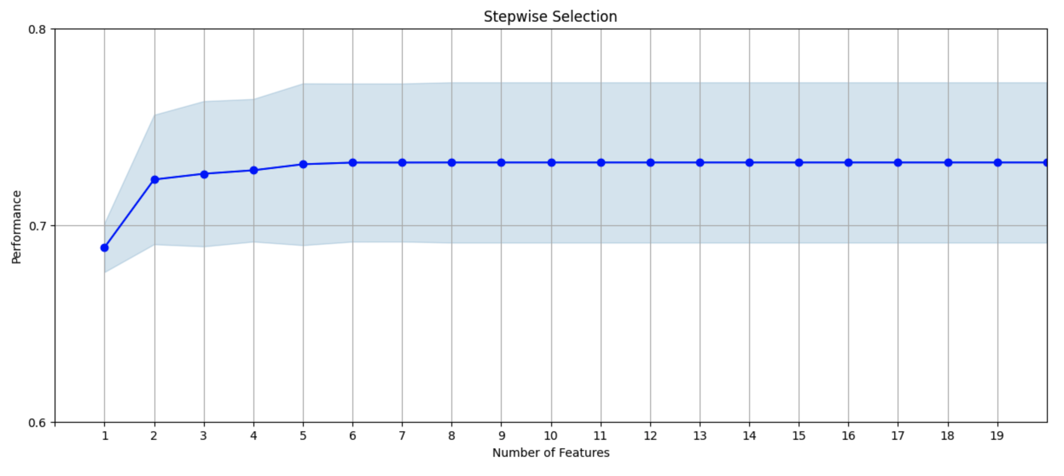
Feature Selection: Wrapper
Next we use a wrapper feature selection method, which is more accurate but slower.
It’s called a wrapper because there is a model build wrapper around the feature selection process. We’ll use a very common approach called forward selection.
Here we keep adding in all possible variables, selecting the best additional variable at each step.
From this picture we decide to keep the top 10 variables for our final modeling.
We then keep adding in one variable at a time, always selecting the next variable that adds the best predictive power.
…
At some point the model performance saturates, and the result is a minimal list of variables that combine to give the best performance.
We build a univariate model with each of the 40 candidate variables. We select the best single variable.

Slide 40
Modeling Results
We spent a bit of time tuning the hyperparameters for each model type
Looks like LGBM works pretty well for this data.
We’ll choose this model.
Training data
Testing data
Validation data
Boosted tree: Light Gradient Boosted Machine
Boosted tree: Catboost
We have three measurements for each model build. The model is built using bootstrap with training and testing data, then validated with a holdout data set.
Model performance (higher is better)
Important observation: Training, testing and validation are all very similar for each model so there’s no obvious model overfitting.
Random forest
Logistic regression
Exploring different model algorithms

Slide 41
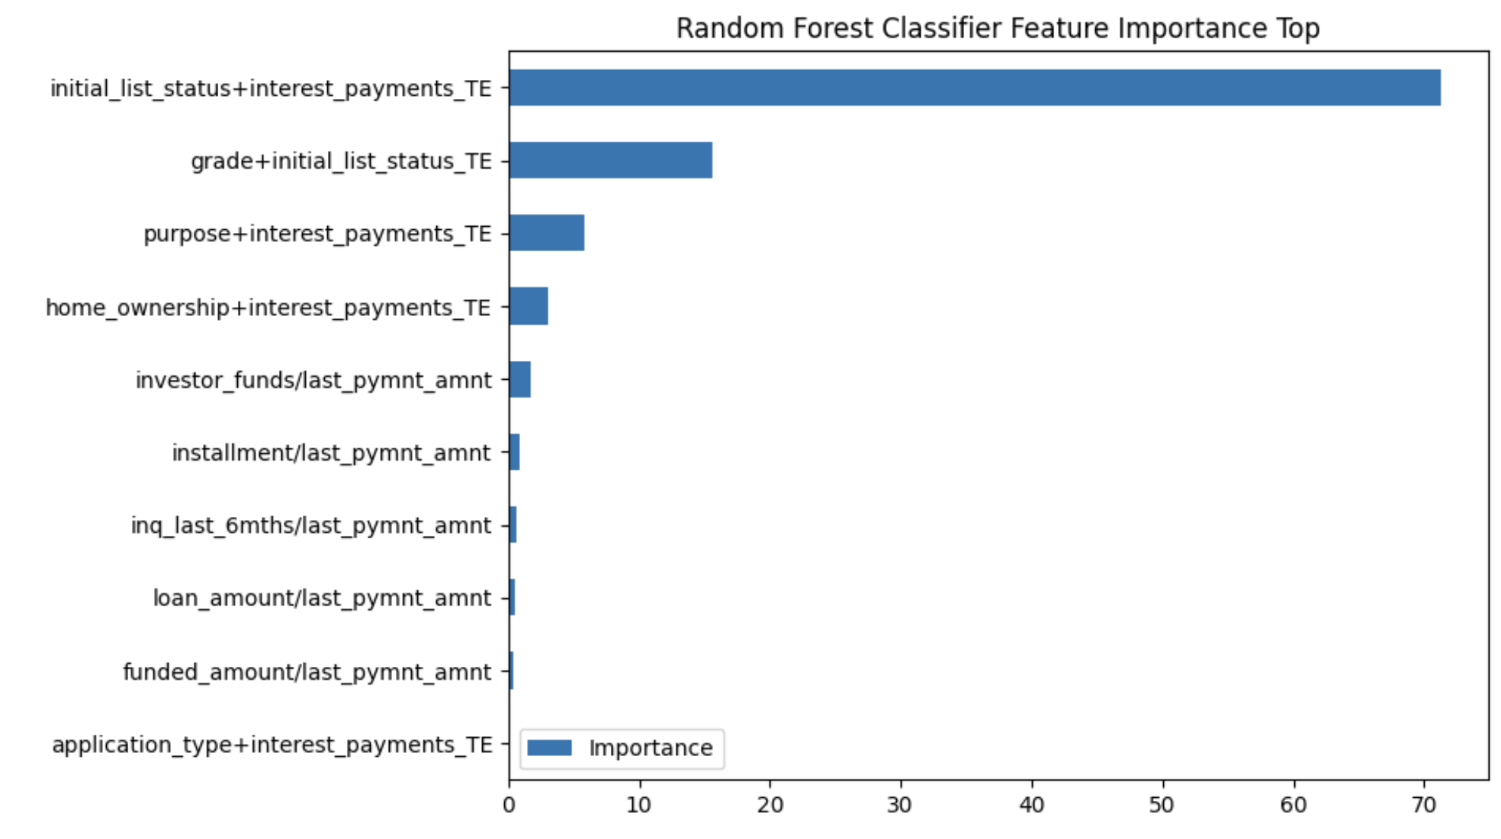
Always Look at What Variables Are the Most Important
Ask yourself: Do they make sense? Is it possible that there is a target leak? Any variable(s) that look too predictive?
I’m not really happy with these variables. When target encoded variables are at the top I worry about overfitting.
Let’s remove these top TE variables and retune the model. We’ll see if other variables can step up and keep the model performance about as high.

Slide 42
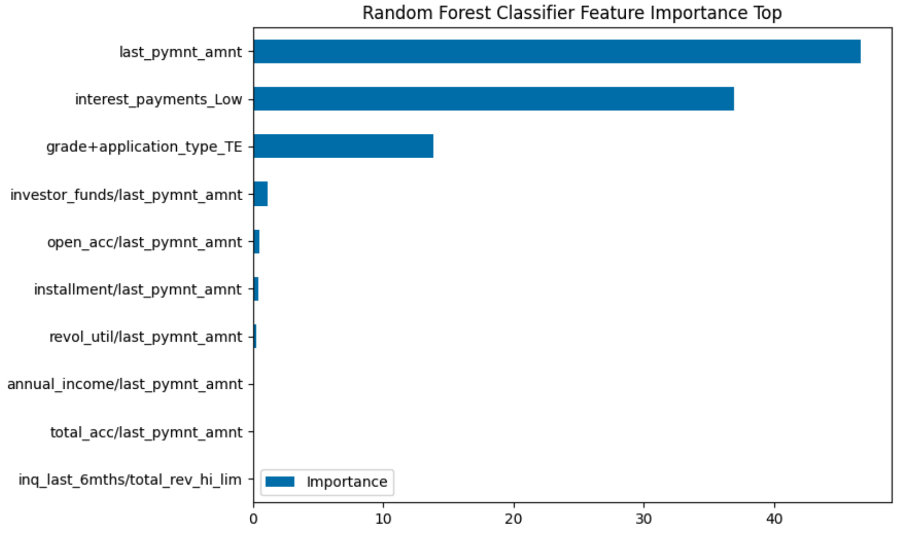
Remove the Suspicious Variable and Rebuild
TE’s the most important v’s
Validation ~55
Original model
TE’s not the most important v’s
Validation ~54
Keep removing TE variables until the highest is not a TE variable
Performance went down a little, but this is a safer model. I think I’d go with this one.

Slide 43
Model Results Table
The score’s KS is about 41, which is reasonable.
We can look at the cumulative bad rate to decide a score cutoff.
Example (red): if you can tolerate an overall bad rate of about 10%, you can set a score cutoff at around 712.
This would allow you to hold about 48% of loan accounts.
Example (green): if you want an overall bad rate less than 1%, you can set a score cutoff at around 800
This would allow you to hold about 20% of loan accounts.
We divide the population into 40 bins of equal # loans
Bin statistics:
What’s in each bin
Cumulative statistics:
Everything up to and including that bin

Slide 44
Credit Score Summary
There are many different kinds of credit models, differing by what they score (application, account, person) and the business use (new account, existing account, person’s reputation). Many are used for multiple different purposes.
The model design is the most important step. Here we think carefully about
What is the business purpose
What will be scored (application, existing account, person)
What data to be used
How to define the goods/bads/indeterminates
How to organize/arrange data into records
The model build process is straightforward but requires thinking and experience
Clean data
Build features/variables
Feature selection
Model tuning
Examine results, implement

Slide 45
Break

Slide 46
Dr Steve’s Advice to Avoid Fraud
Beware of unsolicited contacts. When someone contacts you (email, phone, letter…) you really have no idea who they are. You can always politely thank them and then contact the institution they claim to be from using a valid method, not one they give you.
Be careful giving out any nonpublic personal information, primarily your SSN, date of birth, account numbers.

Slide 47
Class Review and Summary

Slide 48

Two Kinds of Fraud Algorithms
Review
All events to be judged
Made manually by experts
Expert rule systems, also called filters
General statistical/machine learning models
Supervised
linear models: Linear or logistic regression
Nonlinear: decision tree, neural nets, random forests, boosted trees, SVM, naïve Bayes…
Unsupervised
z score outliers
Autoencoders (linear, nonlinear)
Some are caught by a filter
Rule systems are made by domain experts. Often this is a good place to start.
They don’t require data science, only good business experience.
Possible fraud events
Most events just flow through
Made using statistical/machine learning algorithms
This is what we’ll be doing in this class.

Slide 49
Predictive Analytics Pipeline in Business
Review
Most important slide in this class
Business value: ~50% to company changing
Business value: ~20%
This is the most important step
This is the second most important step
Design Solution Approach
Gather Data
Prepare Data
Feature Engineering
Feature Selection
What is goal?
How will it be used?
How to frame the problem?
Many sources,
many files,
different entities
Assemble.
EDA.
Cleaning.
As many as possible.
Anything you can think of.
Minimize dimensionality.
Filter, then wrapper.
Most academic papers are about this step. That’s why they’re not that useful to industry.
Baseline Model
Nonlinear Model
Implement Model
Linear or logistic regression.
Try many with some coarse tuning.
Decide your favorite, fine tune.
Evaluate using appropriate business metric.
Install in business process.
Monitor.
Rebuild when necessary.
Most people think this is the most important step, but it’s not
Business value: ~5%

Slide 50
Supervised Vs. Unsupervised Modeling
Review
Unsupervised
Supervised
x₁ x₂ x₃ … x_{n}
x₁ x₂ x₃ … x_{n} y
All you have are independent variables
x₁ x₂ x₃ … x_{n}
x₁ x₂ x₃ … x_{n} y
You also have a dependent variable y
x₁ x₂ x₃ … x_{n}
x₁ x₂ x₃ … x_{n} y
x₁ x₂ x₃ … x_{n}
x₁ x₂ x₃ … x_{n} y
x₁ x₂ x₃ … x_{n}
x₁ x₂ x₃ … x_{n} y
x₁ x₂ x₃ … x_{n}
x₁ x₂ x₃ … x_{n} y
…
…
Find relationships
Find structure
Find anomalies
Build y = f(x) from data examples
Lots of uncertainty
Never really know how well you’ve done
Clarity of goal
Easily see how well you’ve done
In general, we always build supervised models when possible

Slide 51
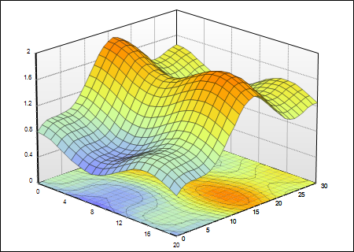
Supervised Machine Learning is Fitting a Surface
Review
2nd most important slide in this class
The surface is y = f(x)
We start with a bunch of data points that come from some measurements
y
x₁ x₂ x₃ … x_{n} y
Many
thousands or millions of records
x₁ x₂ x₃ … x_{n} y
x₁ x₂ x₃ … x_{n} y
x₁ x₂ x₃ … x_{n} y
x₁ x₂ x₃ … x_{n} y
…
x₂
x₁
Many tens or hundreds of variables
Think this way for data preparation: cleaning, imputation, statistical analysis, normalization…
Think this way for model building process, algorithm design and tuning
Building a supervised machine learning model means fitting a best surface through the data points. This is the pretty much all we do when we build a predictive model.
The art of model building is finding this “best” surface.
Notes:
Cleaning,

Slide 52
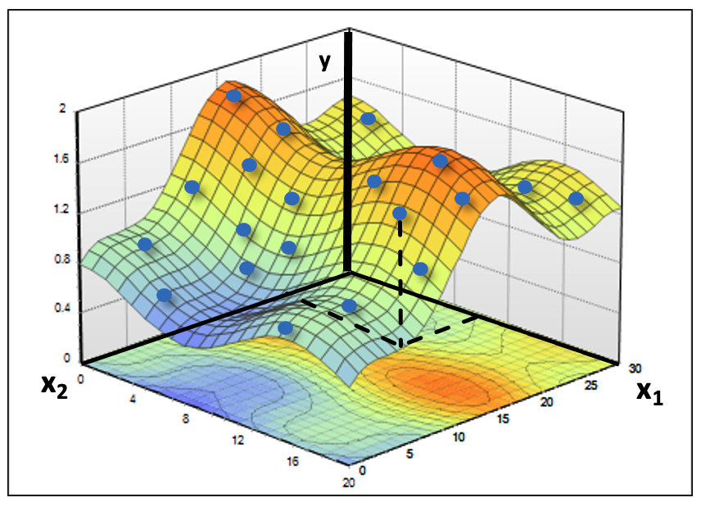
Machine Learning Algorithms Are Dumb
Review
People think ML algorithms are intelligent (AI)
In fact they are simply “curve fitting”: fitting a surface through a bunch of data that you show it.
Clever construction of the input space (word organizations, sentences…) can make the algorithm appear to be intelligent.
This is what a supervised model is doing: finding y=f(x)
Important principles
Do everything you can to help your models find the desired surface.
Make your data as simple and clean as possible, as best as possible relating the x’s to the y.
Build explicit expert variables (ratios, max/mins, combinations, target encodings…). Don’t make your algorithm try to discover them.
Minimize dimensionality.
Notes:
Build expert variables

Slide 53
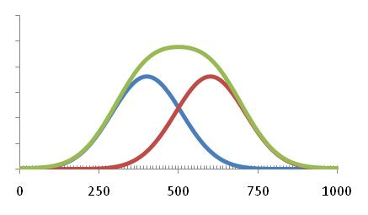
General Model Measures of Goodness
Review
actual
predicted
Numeric Regression ($ loss, profit…). Use sum of squared error, MSE or R².
Each record has an error. Just add up the errors, or the square of the errors.
Binary classification (good/bad). Use KS, ROC/AUC, DR
KS is a robust measure of how well two distributions are separated (goods vs bads).
Detection rate (DR) is best for an imbalanced binary classification.
Marketing models frequently use Lift
Target marketing models are a particular type of binary classification. Marketing managers like to use lift.
Lift of 3 means response is 3 times random.
actual
average
# records
# variables
Adjusted R² takes into account the number of variables. It’s a good measure to use to explore changing # training records, variables.
All records
# in that bin
goods
bads
Model score bin
Cumulative Lift over random
random
Model score bin

Slide 54
Building Supervised Models
Review
Prepare data carefully.
Decide about any weighting/stratification/sampling.
Build a baseline linear model.
Try several nonlinear ML models, do some hyperparameter exploration.
Choose your favorite and tune it well. Focus on the business metric of goodness.
If time allows try ensembles of different models, stacking of models.

Slide 55
Data Preparation for Supervised Models
Review
Do a DQR, share with the data provider, identify any issues.
Explore and study the data. Look at distributions, relationships to the dependent variable.
Clean the data. Outliers, exclusions, imputation as needed.
Thoughtfully decide a plan for training/testing/holdout data.
Interview domain experts. Build expert variables, as many as possible. Transform the categoricals into numeric.
Do feature selection. Filter then wrapper. Get down to a few 10’s of variables.

Slide 56
Data Cleaning: Three Parts
Review
Outliers. We look for and usually do some treatment of records that have outlier values on a field.
Exclusions. In many modeling projects there are certain data records that for some reason we don’t want the model to learn from.
Imputation. We try to fill in missing fields with the most typical value for that field for that record. We look at other fields that we think are related and use the y average for those groups.

Slide 57
Building Unsupervised Fraud Models
Review
Fully understand the problem, the data, the goals.
Understand the modes of fraud that might be occurring.
Build expert variables that are possibly good quantifications of the fraud modes. Build a reasonable number that cover the different possible fraud modes.
Reduce dimensionality and remove correlations via PCA. Do your scaling thoughtfully, for example z scale, PCA, z scale.
Now you’re in the right space. Just look for outliers. Can use distance to origin, autoencoder, whatever.
For unsupervised modeling the key is building the right space. The algorithms after that are trivial.

Slide 58
What Do We Do With Data to Build a Model
Review
Raw data
Cleaned data
Some values are 0 when they should be nonzero
L+1 columns
L+1 columns
f₁ f₂ f₃ …. f_{L} y
f₁ f₂ 0 …. f_{L} y
f₁ na f₃ …. f_{L} y
…
f₁ f₂ na …. f_{L} y
Clean the data:
Fill in missing fields
Treat outliers
Remove exclusions
f₁ f₂ f₃ …. f_{L} y
f₁ f₂ f₃ …. f_{L} y
f₁ f₂ f₃ …. f_{L} y
…
f₁ f₂ f₃ …. f_{L} y
M rows
m rows
The fields f are still anything
Some values are missing
Typically missing “bad” field values
The fields f can be numbers, characters, strings, names, addresses, anything
Feature engineering: build n expert variables from the L fields
Data for the model
n+1 columns
The variables x are all numbers
x₁ x₂ x₃ …. x_{n} y
x₁ x₂ x₃ …. x_{n} y
x₁ x₂ x₃ …. x_{n} y
…
x₁ x₂ x₃ …. x_{n} y
n independent variables (x’s)
One dependent variable (y)
Many more rows than columns (m >> n)
The goal is y=F(x)
m rows

Slide 59
Most Common Kinds of Data Fields
Review
Numeric
Could be continuous or discrete (e.g., integer counts).
There is a metric/measure – a concept of size, order and nearness.
Categorical
There is no natural ordering.
Examples: A, B, C… or Type 1, Type 2, Type 3…
These are fundamentally different from numbers because there is no metric - no sense of size, nearness or ordering.
Don’t be confused by a field that looks like a number but is really representing a category, like Product 1, 2… or Store 102, 103…
Strings should be considered categorical and will generally have very large cardinality (# different values).
Datetime fields can be considered either numeric or categorical, whichever makes sense for that particular problem.

Slide 60
Making Variables From Numeric Fields
Review
Research the problem deeply and try to understand the possible relationships of the fields to the dependent variable.
The best variables come from talking to the domain/business experts. They’ll tell you stories and give you ideas about how to combine numeric fields into expert variables.
Some of the best expert variables come from combinations and ratios of numeric fields.
If you don’t have an expert to guide you, you can just make all possible ratios of all numeric fields.

Slide 61
How to Do Encoding for Categoricals
Review
Consider a categorical field, say f₆, that has four possible values: A, B, C, or D
Could use a dummy variables: f₆ is transformed into 4 variables x₁, x₂, x_{3,} x₄ such that
This is not optimal for high-cardinality fields. Can greatly expand dimensionality.
Better to use Target Encoding: build a table with values for each category:
Calculate y_{A}=<y>|_{f6=A}, y_{B}=<y>|_{f6=B}, y_{C}=<y>|_{f6=C}, y_{D}=<y>|_{f6=D}
Then encode f₆ as
One hot
Binary
x₁ x₂ x₃ x₄
x₁ x₂
1 0 0 0
when f₆=A
0 0
when f₆=A
x_{new} =
0 1 0 0
when f₆=B
1 0
when f₆=B
f₆ ->
when f₆=C
f₆ ->
x_{new} =
0 0 1 0
0 1
when f₆=C
0 0 0 1
when f₆=D
1 1
when f₆=D
y_{A} when f₆=A
This means average
y_{B} when f₆=B
This means evaluated for
f₆ ->
x_{new} =
y_{C} when f₆=C
y_{D} when f₆=D

Slide 62
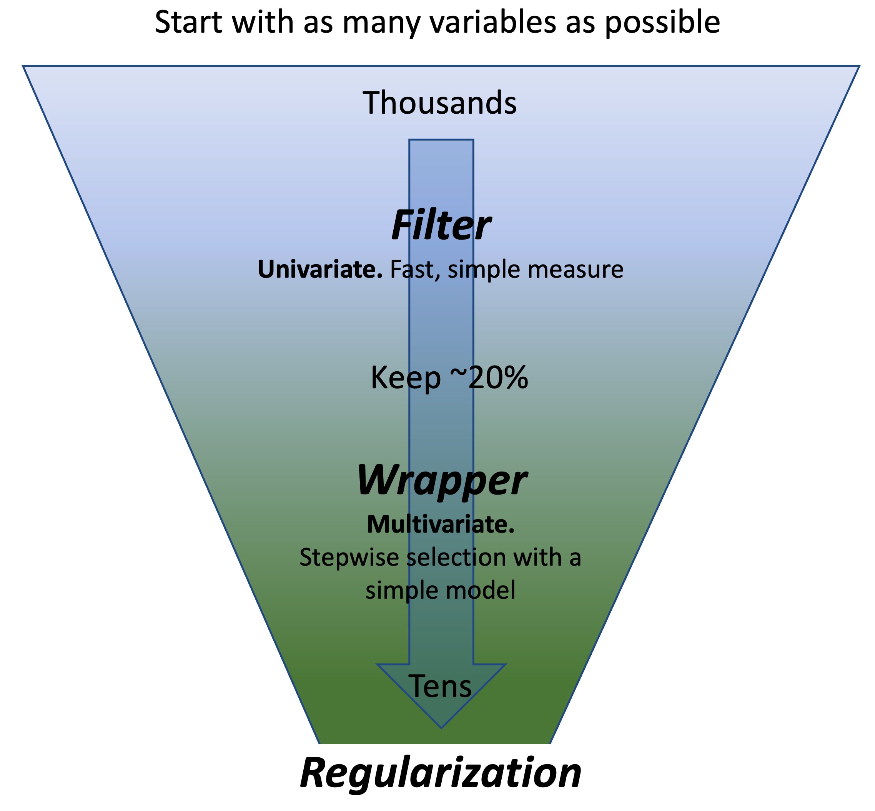
Feature Selection Methods Ways to categorize feature selection
Review
Filter – independent of any modeling method
Measure the univariate relationship of each x_{i} to y
Wrapper – uses a model “wrapped” around the feature selection
stepwise selection (forward, backward)
Embedded – does feature selection as the model is built
Decision trees
Use of a regularization (ridge, lasso)

Slide 63
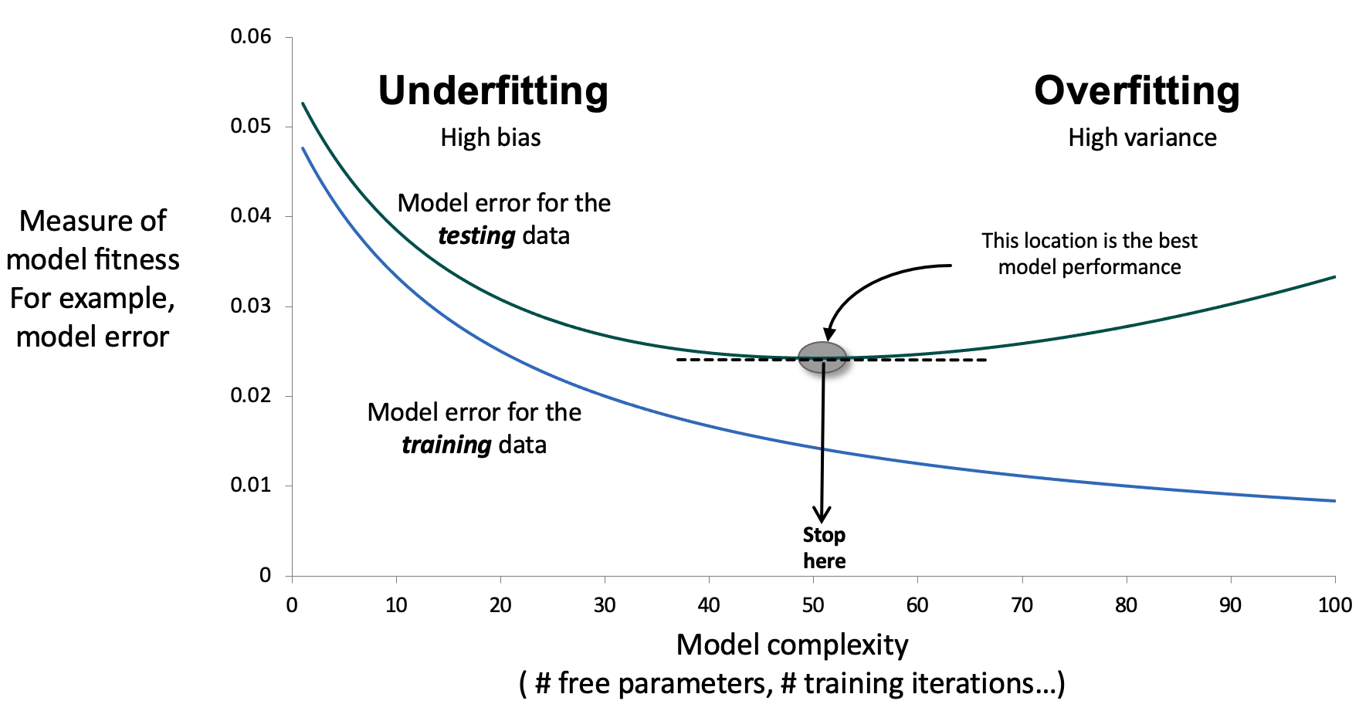
How to Tune Model Hyperparameters
Review
This is what we’re doing
Always start with a linear model. Linear models are robust, hard to mess up, and will provide a baseline result. Later all your nonlinear models should be able to do at least this well.
With each nonlinear model type (NN, BT, RF…) always start with minimum complexity. The results will likely be worse than your linear model.
Increase complexity, watch the trn and tst performance. Gradually try to overfit, where the trn is much better than the tst.
Then back off complexity to try to balance the trn and tst so that the tst is as good as possible, keeping the trn not much better. If the trn is much better than the tst, the model is overfitting.
A good model will have a good trn performance and the tst good and just a bit worse the trn. This model is not overfitting, will generalize well and be stable and robust going forward.
Want minimum complexity that gives good tst performance.

Slide 64
ML Advice and State of the Art

Slide 65
Dr. Steve’s Rules for Machine Learning
Fully understand the problem you’re trying to solve before beginning. Talk to the domain experts. What is your goal? How will your results be measured? Frame the problem.
Get as much data as possible. You can never have too much data.
Fully understand your data, all the fields, where it came from, where it will come from.
Do a complete statistical analysis on your data. Do a DQR, explore distributions, correlations, relationships. Talk to the domain experts about what you see.
Build expert variables carefully, creatively, exhaustively. Talk to the domain experts to encode any dynamics they describe. Build clever variables in order to minimize the work of your algorithm. Build as many variables as possible for supervised problems.
Minimize dimensionality using the appropriate feature selection processes.
Do everything you can to minimize the work required by your ML algorithm. This is primarily many expert variables and dimensionality reduction.
Get a baseline answer with a simple method.
Try various ML methods. Start with minimal model complexity. There is no known-best for any problem. Always start simple, then increase complexity until you see overfitting.
Understand any ML method you use.
Be skeptical of everything, particularly if your results look too good. If it might be wrong it probably is.

Slide 66
Dr. Steve’s Pretty Good Flowchart for Predictive Models
Start
Find Structure in the Data (Cluster)
K means, fuzzy c means
Hierarchical statistical clustering
Talk to Experts
What is goal: find structure or anomalies?
Build expert variables**
Z scale
Find Structure
Reduce Dimensions
Guidance by experts
Autoencoder
PCA
Have a dependent variable y?
No
unsupervised
Find outliers/anomalies
(fraud)
Find Outliers
Autoencoder error
Zscore outlier
supervised
Yes
Talk to Experts
Build expert variables**
Z scale
Nonlinear Model
Boosted trees,
Random forest,
Bayesian, NN
Ensemble, stacking
Multi category
label
Baseline Model
Knn
Label is
categorical or numeric?
Categorical
Reduce Dimensions
Univariate KS, KL (filter)
Stepwise selection (wrapper)
Classification
Nonlinear Model
Boosted trees,
Random forest,
NN, SVM,
Bayesian
Ensemble, stacking
Binary label
Baseline Model
Logistic regression
Numeric
Regression
Reduce Dimensions
Univariate models (filter)
Stepwise selection (wrapper)
Nonlinear Model
Boosted trees,
Random forest,
NN, Bayesian
Ensemble, stacking
Baseline Model
Linear regression
**Inputs include text?
Use NLP to encode
**Inputs include images?
Use CNN to encode
66

Slide 67
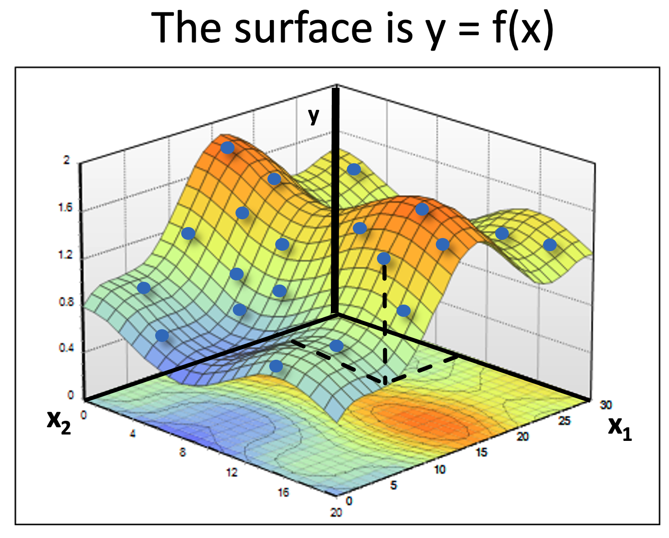
Evolution of Predictive ML Algorithms
From about 1960 to 2000 it was mostly about better surface-fitting algorithms. (BT, RF, SVM, RBF, NB, KNN…)
Since then it’s been more about
Clever methods for combining existing pieces (ensembles, stacking, GAN)
Improvements in encoding inputs (CNN for images, tokenization for NLP…)
Improvements in NLP architectures (LSTM, GRU, transformers via attention…)
Since ~2020 it’s AI: transformers for LLMs, GANs and Generative Diffusion for images, video.
For numerical/categorical data: boosted trees, neural nets, random forests.
CNN for image processing.
Ensembles of strong models help with generalization and stability.
Stacking improves model performance. Can also use stacking to combine models built on different subsets of data.
Transformers for NLP LLMs (ChatGPT…)
GANs and Generative Diffusion for image and video (4o, Imagen, Dreamwave, Veo…)
ML best practices

Slide 68
Current State of Machine Learning
Machine learning is either
Supervised. Then you’re building y = f(x) with an adaptive surface fitting algorithm.
Unsupervised. Then you’re looking for structure/clusters or outliers/anomalies.
Hybrid methods: reinforcement learning or semi-supervised learning.
Current best practices applications and theory:
Clever combinations of components: stacking, generative, hybrid learning…
Clever encoding methods for particular input types: CNN for images, tokenization for text.
Transfer learning from massively-trained starting points (LLMs).
Ability to field/use massive architectures due to better hardware, data architectures, software, algorithms. Allows powerful new new tools and applications:
Transformers in LLMs to generate sophisticated text.
GAN and Generative Diffusion to generate amazing images/video.
Use a generalized objective function
Some records have y’s. Use that supervised model to put y’s on the other records.

Slide 69
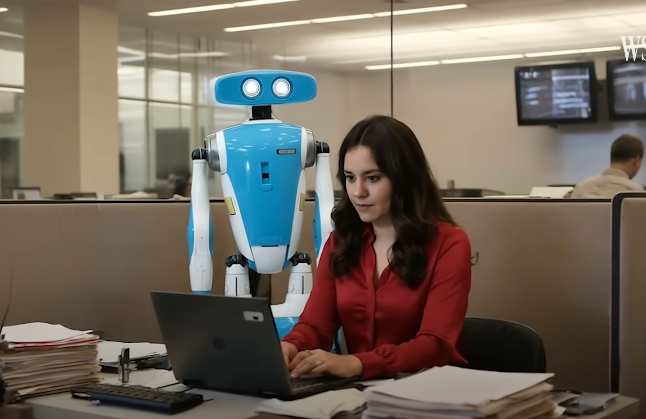


What Can AI Do?
Generate text and documents virtually indistinguishable from human-created.
This allows real time interaction with chatbots that seem human.
Read text or interact using someone’s “stolen” voice.
Generate pictures from text descriptions.
Make “deep fakes”:computer-generated pictures and videos that look very real.
Create new image or video content. We’ll see complete movies made by AI.
Deep fake making Mona Lisa talk
Scene from movie “My Robot and Me.”
Movie completely AI generated.
https://www.youtube.com/watch?v=US2gO7UYEfY&t=32s

Slide 70
Hierarchy of Value For Business Models
Below is the sorted list of what brings the most improvement to models.
Biggest leverage
Model framework/design: What are you predicting? Supervised vs unsupervised? How will the model be used? How will you treat time? How will you build records? What entity levels?
Data: What data is available? Can you get additional data?
Variables: Create domain expert variables that relate x to y.
Algorithms: Well-made nonlinear models.
In many instances the design (1) and available data (2) are given.
But always good to think about possible changes/improvements.
Least leverage
What we did in this class

Slide 71
Examples of High-Leverage Design Decisions
What entity level? Account, person, household, email, phone #, mailing address…
How to treat time? What frequency? Monthly, weekly, daily, hourly… Irregular frequencies. Mismatched frequencies. How far back in time? How to divide into train, test, validation?
Model segmentation?
y = f(x) or y =
How to design the dependent variable?
f₁(x₁)
f₂(x₂)
Different models for different populations,
likely with a different set of best variables.
Perhaps y = y₁ + y₂ and model each separately
Maybe y = y₁ * y₂ and model each separately
Fairly common and tends to work well when the drivers of y1 and y2 are different.
Multiplying models can substantially increase error.
Examples of thoughtful design of the dependent variable:
Predict Profit y = Revenue - Loss, but predict Revenue and Loss each with their own model?
Predict cross-sell Revenue y = Prob_{accept} * Revenue_{if_accept} and predict each separately?
Predict credit card losses as a fraction of exposure. Citibank first predicts Prob_{loss}, sorts all accounts by Prob_{loss}, then calculates loss ratios = Σ losses / Σ card balance. Or predict loss ratio directly.
Others: Cross-sell optimization, matrix approach. Stock derivatives pricing.
How we started first company, CASA, 1995.
How we sold first company, CASA to HNC, 2000.
Why Morgan Stanley bought third company, LACG,2005.

Slide 72
What You’ve Done/Learned
FINAL CLASS SLIDE
How to approach a fraud problem
Ask lots of questions, understand the fraud dynamics and the data.
How to process messy, raw data
Explore the data, do a DQR, interact with the data provider. Clean data: exclusions, imputation, outliers.
How to build expert variables
Listen to the domain experts, think about combinations of fields that can indicate fraud. Use entities, groupings (linking), ratios, normalizations, profiles (typical behaviors).
Transform categorical fields into numeric variables via dummy variables (OK) and/or target encoding (better).
Feature selection/Dimensionality reduction
Supervised: Filter followed by wrapper. Get down to a few 10’s of variables sorted by multivariate importance.
Unsupervised: z scale, PCA, keep just a few PCs, z scale again.
Build preliminary models
Supervised: Build a linear baseline model. Explore several nonlinear algorithms.
Unsupervised: either a zscore outlier or autoencoder
Select, tune and finalize your model
Tune: Start with minimal complexity. Increase until overfitting. Back off to where train just a little better than test.
Supervised: Build tables and financials for the report.
Unsupervised: iterate with the domain experts/investigators. Adjust exclusions, variables.
Write and deliver the report
The report describes all the steps you did in enough detail for someone to reproduce everything.
Machine Learning and other topics: trees, forests, boosting, ensembles, stacking, neural nets, clustering, avoiding overfitting, cross validation, objective function, fitness landscape, regularization, local minima, model tuning, PCA, score scaling, distance measures, fuzzy matching, score calibration, model compliance, reject inference, credit models.

